Slide 1
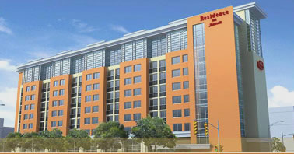

Now Featuring Executive Office Suites
DEVELOPING A PROTOTYPE
Presented by:
Katie Ritter
Faculty Advisor:
Dr. Ali Memari

Slide 2
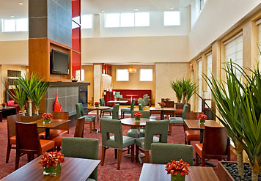
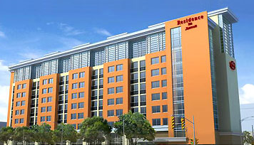
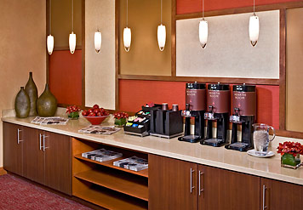

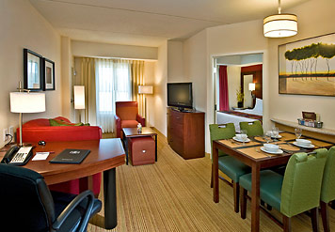
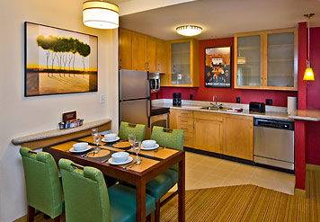
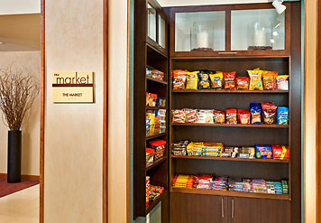
Residence Inn by Marriott
Katie
Ritter
All-suite hotel for extended-stay guests
Fully-equipped kitchens in each suite
Ground floor amenities:
  Laundry facilities for guests
  Indoor pool / spa / fitness
DEVELOPING A PROTOTYPE
STRUCTURAL OPTION
Original Design:
Downtown Norfolk, VA
9 Stories ~ 108’ Ht.
130,000 GSF
160 Guest Suites
$22 Million
Completed January 2009
Residence Inn
Proposal & Goals
Original Structure
Architectural Design
Gravity System Re-Design
Lateral System Re-Design
Summary & Next Steps
Questions
Faculty Advisor:
Dr. Ali Memari
The Pennsylvania
State University
April 14, 2009
“A home away from home.”

Slide 3
Proposal & Goals
Katie
Ritter
DEVELOPING A PROTOTYPE
ARCHITECTURAL BREADTH
Design new office suite floors
  Embrace upscale design
  Provide green roof space for residents
  Maintain all existing vertical transportation routes/mechanical shafts & penetrations
LIGHTING BREADTH
Innovative conference room lighting design
STRUCTURAL DEPTH (part 1)
Check original floor design for increased loads
Re-design gravity columns
Re-design transfer girders @ 2nd Floor
STRUCTURAL OPTION
Create a new signature brand for Marriott specifically for the business traveler, adding an office suite dimension to hotel-style living.
Residence Inn
Proposal & Goals
Original Structure
Architectural Design
Gravity System Re-Design
Lateral System Re-Design
Summary & Next Steps
Questions
1
Faculty Advisor:
Dr. Ali Memari
The Pennsylvania
State University
April 14, 2009
STRUCTURAL DEPTH (part 2)
Develop loading criteria for prototype
Apply loads to original structure & analyze
Shear wall re-design
  Develop lateral structural solution that satisfies code requirements with new demands
  Maintain original shear wall locations
  Evaluate feasibility of the prototype structure
    Variables to consider
    Cost
Engineer a prototype structure that is suitable for numerous locations across the U.S.
2

Slide 4
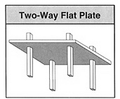
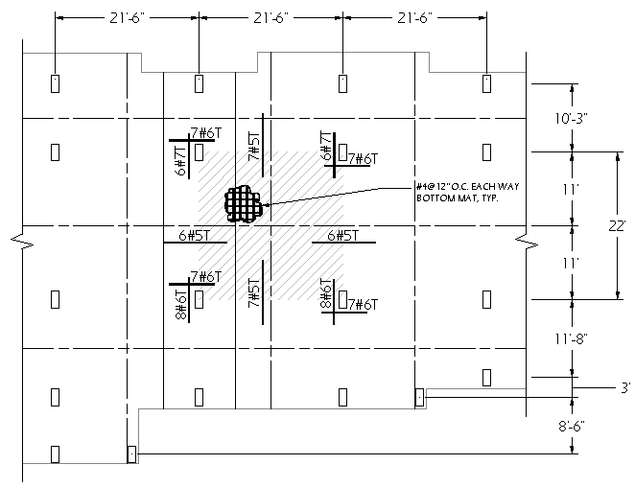
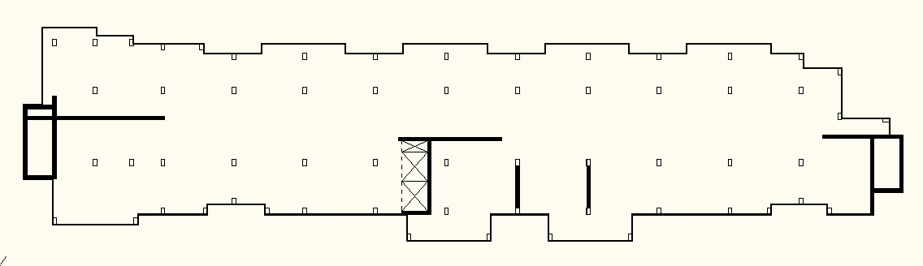
Original Structural Design
Katie
Ritter
DEVELOPING A PROTOTYPE
Floor System
8” slab, typical
22’ max bay size
Most economical
STRUCTURAL OPTION
Residence Inn
Proposal & Goals
Original Structure
Architectural Design
Gravity System Re-Design
Lateral System Re-Design
Summary & Next Steps
Questions
Faculty Advisor:
Dr. Ali Memari
The Pennsylvania
State University
April 14, 2009

Slide 5
Original Structural Design
Katie
Ritter
Lateral System
(14) cast-in-place reinforced concrete shear walls
12” thick, typical
Gravity System
cast-in-place reinforced concrete columns
14” x 30”, typical
DEVELOPING A PROTOTYPE
STRUCTURAL OPTION
Residence Inn
Proposal & Goals
Original Structure
Architectural Design
Gravity System Re-Design
Lateral System Re-Design
Summary & Next Steps
Questions
Faculty Advisor:
Dr. Ali Memari
The Pennsylvania
State University
April 14, 2009
A
B
C
D
E
F
G
H
J
K
L
M
N
P
Q
R
S
1
3
4
6
7
8
9

Slide 6
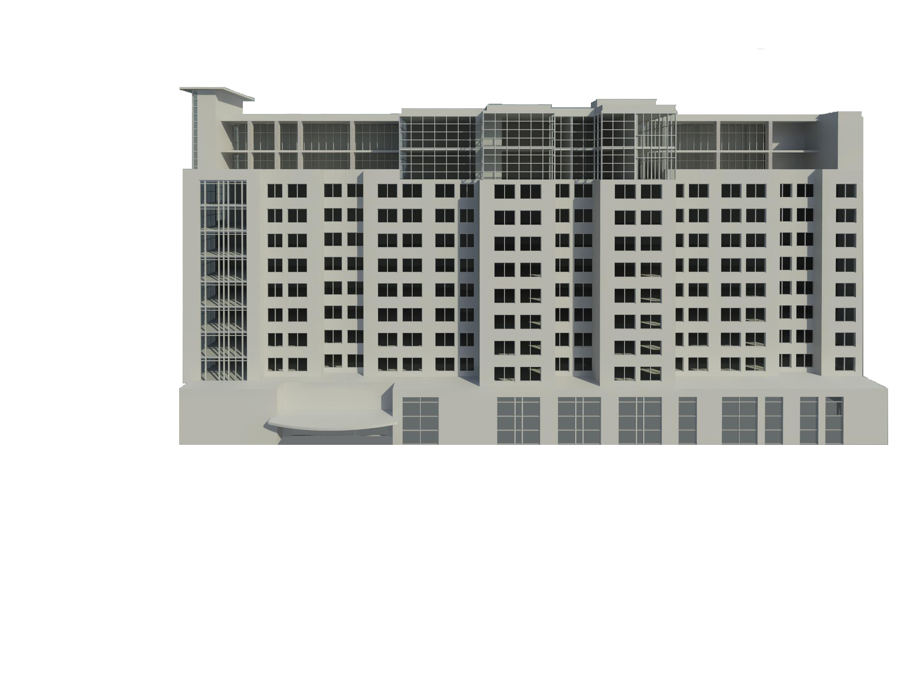
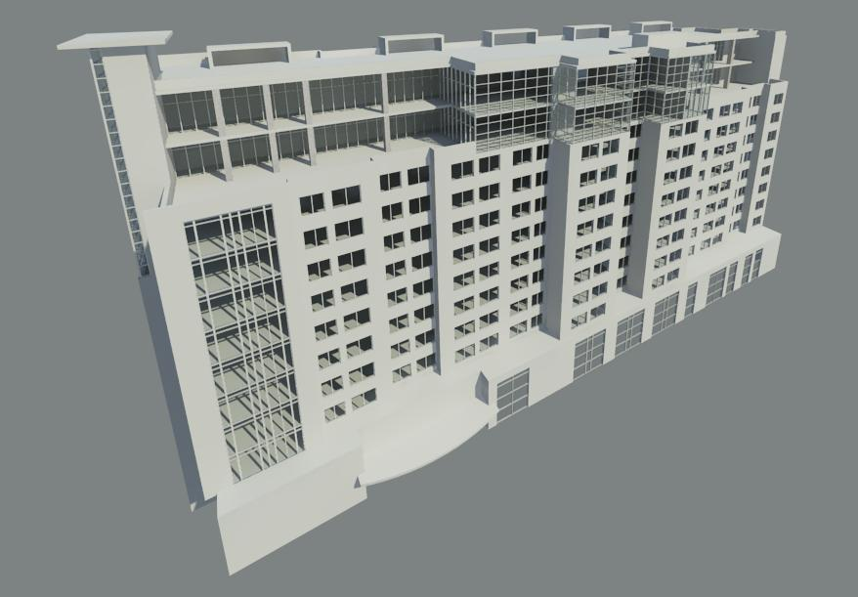
…a new Executive Residence Inn
Katie
Ritter
DEVELOPING A PROTOTYPE
STRUCTURAL OPTION
Residence Inn
Proposal & Goals
Original Structure
Architectural Design
Gravity System Re-Design
Lateral System Re-Design
Summary & Next Steps
Questions
Office
Suites
24’
Faculty Advisor:
Dr. Ali Memari
The Pennsylvania
State University
April 14, 2009
Hotel
Suites
108’
South Elevation

Slide 7
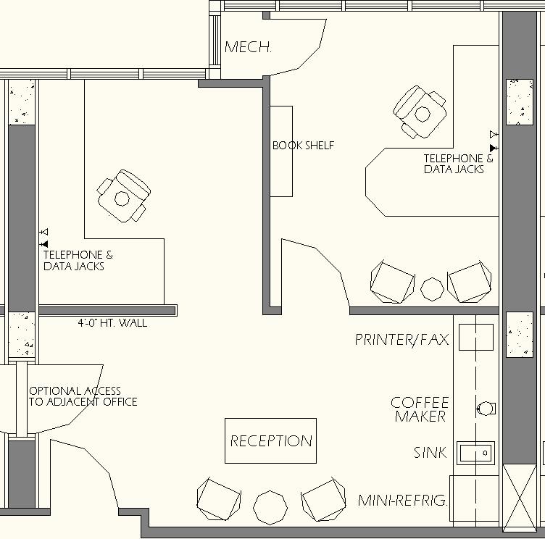
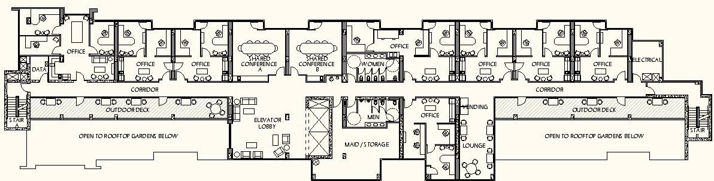
Office Level Floor Plans
Katie
Ritter
DEVELOPING A PROTOTYPE
STRUCTURAL OPTION
Residence Inn
Proposal & Goals
Original Structure
Architectural Design
Gravity System Re-Design
Lateral System Re-Design
Summary & Next Steps
Questions
Faculty Advisor:
Dr. Ali Memari
The Pennsylvania
State University
April 14, 2009
11th Floor Plan

Slide 8



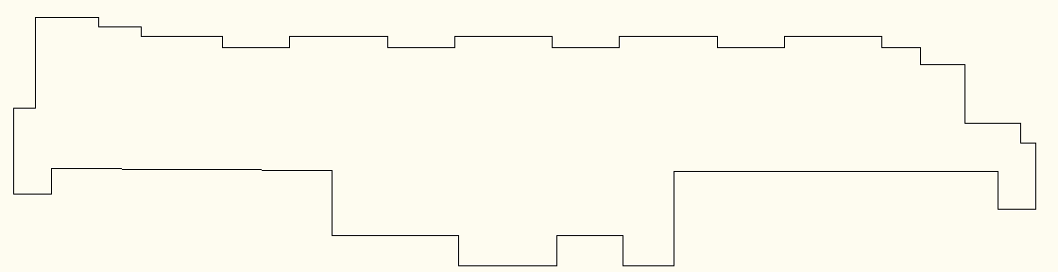
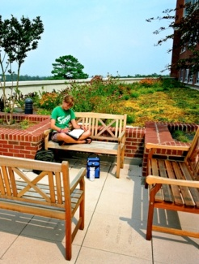


Gravity Loads
Katie
Ritter
Revised Gravity Loads (psf)
Location | Dead (Incl. Self-Wt. of Slab) |  | Live
 | Original | New | Original | New
Roof | 135 | 135 | 30 | 30
11th | - | 150 | - | 50/80/100
10th | - | 195 | - | 50/80/100
Typical Floors 2nd - 9th | 125 | 125 | 40 | 40
DEVELOPING A PROTOTYPE
STRUCTURAL OPTION
Residence Inn
Proposal & Goals
Original Structure
Architectural Design
Gravity System Re-Design
Lateral System Re-Design
Summary & Next Steps
Questions
Modular system
2’x4’ typical
Lightweight
35 psf max wet modules
8 psf pavers made from recycled rubber
Flexibility
Drought-resistant choice of plantings
Customized to
each location
Faculty Advisor:
Dr. Ali Memari
The Pennsylvania
State University
April 14, 2009
10” slab
required
50 PSF
80 PSF
100 PSF
11th Floor
(10” slab)
10th Floor
(10” slab)

Slide 9
Gravity Column Re-Design
Katie
Ritter
DEVELOPING A PROTOTYPE
STRUCTURAL OPTION
A
B
C
D
E
F
G
H
J
K
L
M
N
P
Q
R
S
11th
10th
9th
8th
7th
6th
5th
4th
3rd
2nd
1st
2 @
12’
Residence Inn
Proposal & Goals
Original Structure
Architectural Design
Gravity System Re-Design
Lateral System Re-Design
Summary & Next Steps
Questions
Faculty Advisor:
Dr. Ali Memari
The Pennsylvania
State University
April 14, 2009
1
3
4
6
8 @
9’-4”
7
8
9
19’
17’
Upper Office Floors - Column Layout
Typical Floor - Column Layout
21’

Slide 10
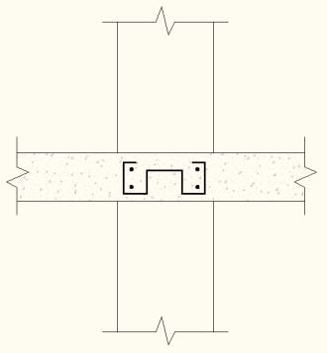
Gravity Column Re-Design
Katie
Ritter
Original Design
14” x 30”
(10) #9
20” x 30” (12) #10
Re-Design
14” x 20”
(6) #8
20” x 30” (12) #10
P_{u,max} = 854 kips
DEVELOPING A PROTOTYPE
STRUCTURAL OPTION
11th
10th
9th
8th
7th
6th
5th
4th
3rd
2nd
1st
2 @
12’
Residence Inn
Proposal & Goals
Original Structure
Architectural Design
Gravity System Re-Design
Lateral System Re-Design
Summary & Next Steps
Questions
Potential Shortcomings of Re-Design:
Floor slab shear reinforcement required
  Double-U Stirrup
  Shearheads
  Cost Impact
Story Drift Impact from Lateral Loads
Faculty Advisor:
Dr. Ali Memari
The Pennsylvania
State University
April 14, 2009
4 ksi
5 ksi
8 @
9’-4”
19’

Slide 11
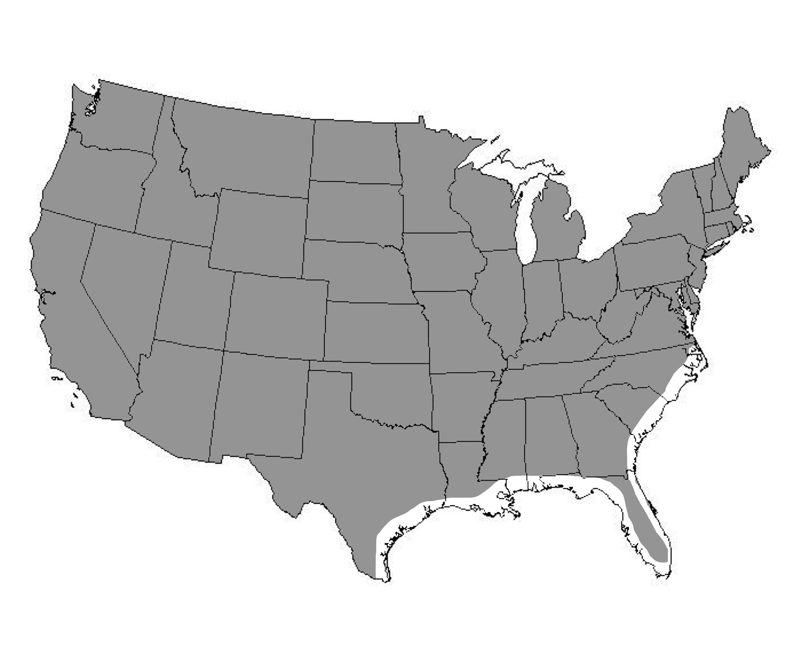
Loading Criteria for Prototype
Katie
Ritter
DEVELOPING A PROTOTYPE
Basic Wind Speed
(3-sec. Gust)
STRUCTURAL OPTION
Residence Inn
Proposal & Goals
Original Structure
Architectural Design
Gravity System Re-Design
Lateral System Re-Design
Summary & Next Steps
Questions
Other Assumptions:
Exposure Category B
Urban & suburban areas with closely spaced obstructions
Not located on a hill
  Topo factor, k_{zt} = 1
Faculty Advisor:
Dr. Ali Memari
The Pennsylvania
State University
April 14, 2009
V ≤ 120 mph
(Norfolk: V=110 mph)

Slide 12
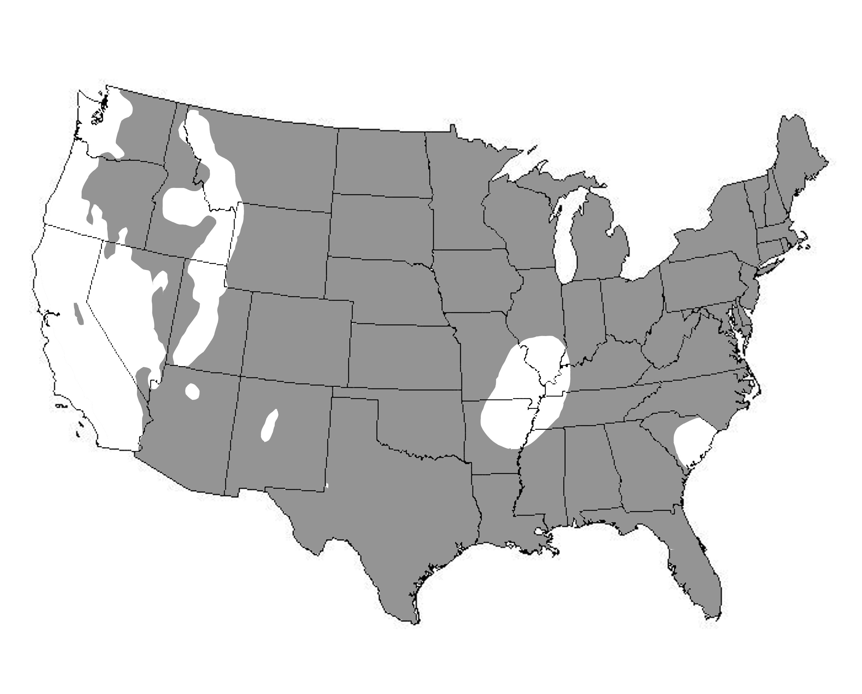
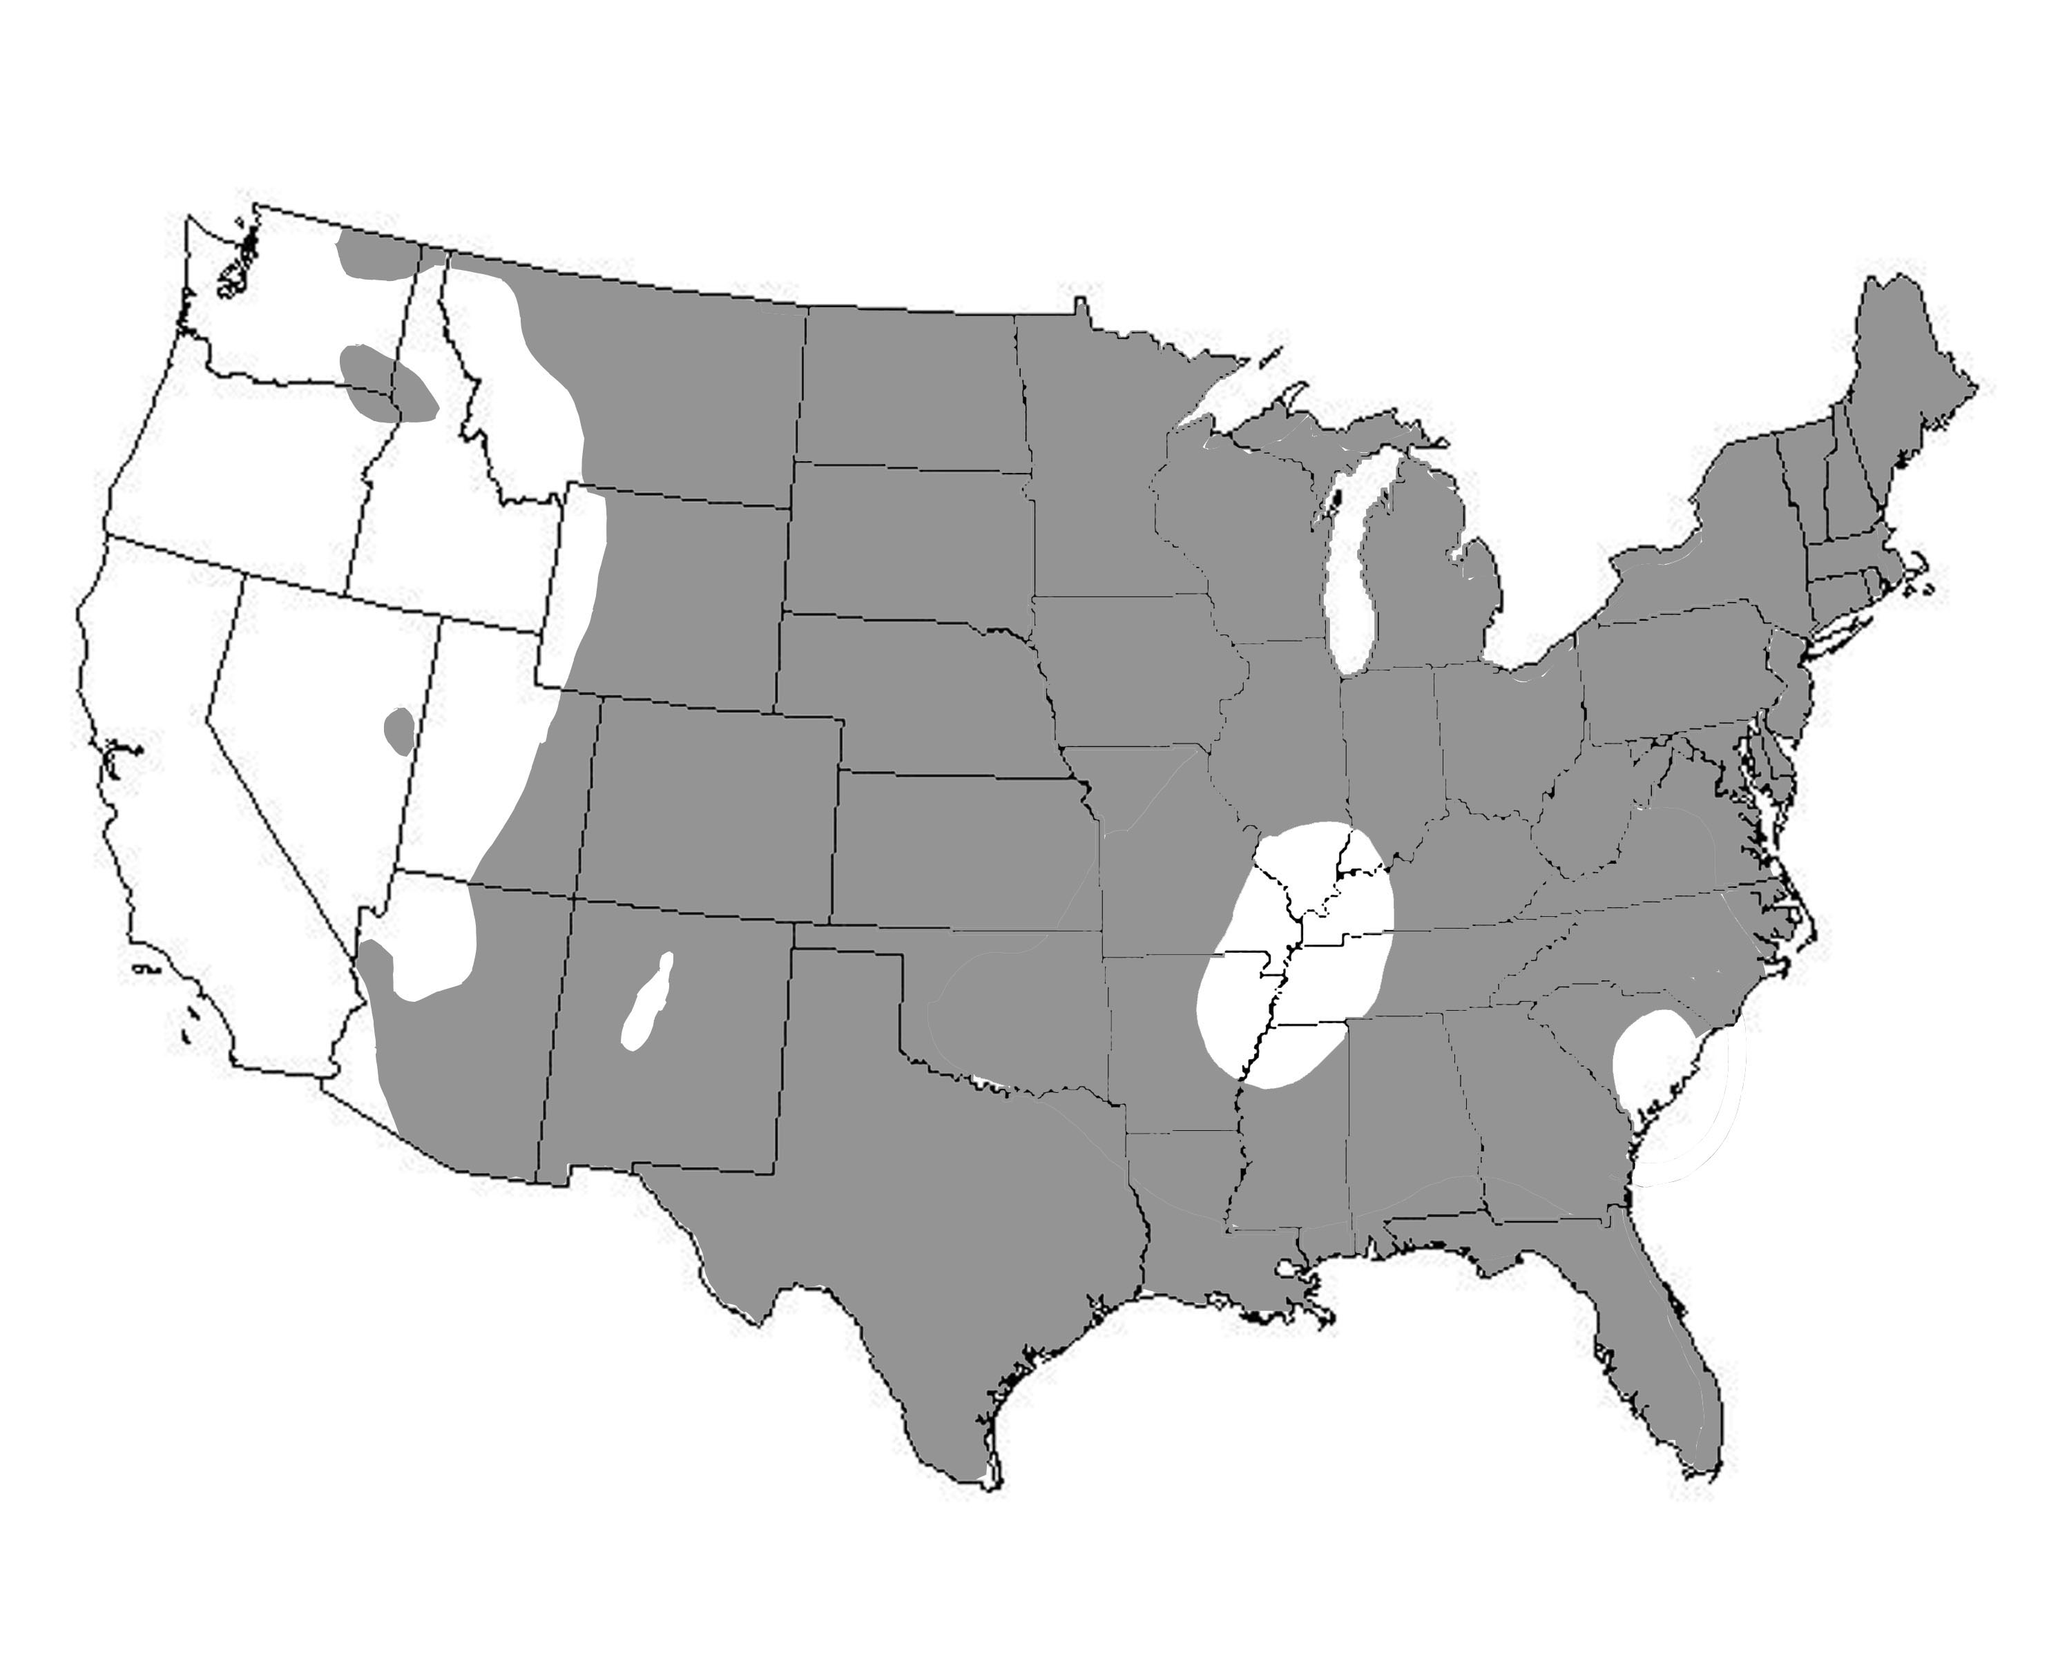
Loading Criteria for Prototype
Katie
Ritter
Seismic Parameters:
Spectral Response Acceleration
DEVELOPING A PROTOTYPE
STRUCTURAL OPTION
Other Assumptions:
Site Class D ~ Stiff Soil
Seismic Design Category D
  Ordinary reinforced concrete shear walls not permitted per ASCE7-05
  Max height for special reinforced concrete shear walls = 160’
    System overstrength factor = 2.5
  Redundancy factor = 1.3
Residence Inn
Proposal & Goals
Original Structure
Architectural Design
Gravity System Re-Design
Lateral System Re-Design
Summary & Next Steps
Questions
Faculty Advisor:
Dr. Ali Memari
The Pennsylvania
State University
April 14, 2009
Short Period, S_{s} ≤ 50
Long Period, S₁ ≤ 15

Slide 13
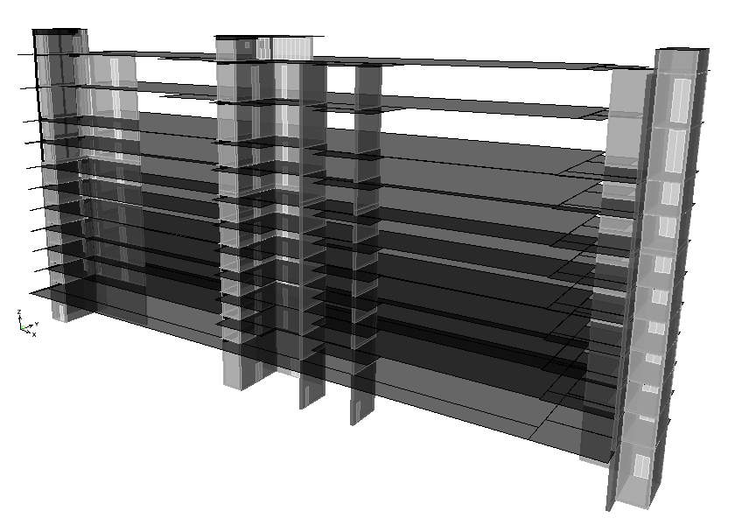
Structural Computer Model
Katie
Ritter
ETABS
DEVELOPING A PROTOTYPE
STRUCTURAL OPTION
Residence Inn
Proposal & Goals
Original Structure
Architectural Design
Gravity System Re-Design
Lateral System Re-Design
Summary & Next Steps
Questions
Modeling Assumptions:
Shear Walls
  Shell areas
  Maximum mesh of 24”
  Cracked sections considered; 50% of stiffness
  P-Delta effects included
Floor Diaphragms
  Rigid
  Null areas with assigned area masses
Faculty Advisor:
Dr. Ali Memari
The Pennsylvania
State University
April 14, 2009
Natural Periods:
T_{x} = 1.077 sec.
T_{y} = 1.436 sec.
T_{z} = 0.857 sec.

Slide 14
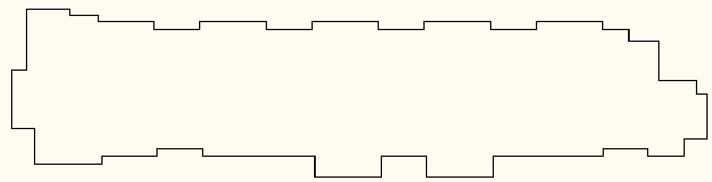
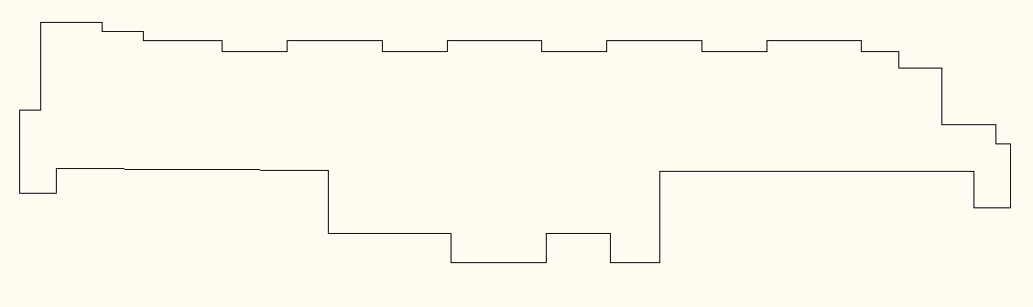
Structural Irregularities
Katie
Ritter
DEVELOPING A PROTOTYPE
STRUCTURAL OPTION
(1a) Torsion
in X-Direction
(1b) Extreme Torsion
in Y-Direction
(2) Reentrant Corner
@ Upper Office Floors
Modal Response Spectrum Analysis Required
Equivalent Lateral Force procedure used to obtain seismic loads for preliminary design
Residence Inn
Proposal & Goals
Original Structure
Architectural Design
Gravity System Re-Design
Lateral System Re-Design
Summary & Next Steps
Questions
Faculty Advisor:
Dr. Ali Memari
The Pennsylvania
State University
April 14, 2009
Y
X
Diaphragm Considerations:
Connections to Shear Walls
Model as semi-rigid

Slide 15
Relative Stiffness of Shear Walls
Katie
Ritter
DEVELOPING A PROTOTYPE
STRUCTURAL OPTION
Residence Inn
Proposal & Goals
Original Structure
Architectural Design
Gravity System Re-Design
Lateral System Re-Design
Summary & Next Steps
Questions
Faculty Advisor:
Dr. Ali Memari
The Pennsylvania
State University
April 14, 2009
Y
X

Slide 16
Controlling Lateral Loads
Katie
Ritter
DEVELOPING A PROTOTYPE
Critical Loads at Base of Shear Walls
 | Shear Wall | Controlling Load Combination | Axial | Shear | Moment
 |  |  | P_{u} (kips) | V_{u} (kips) | M_{u} (ft-k)
X-Direction Loading | SW-2 | (5) | 235 | 12 | 476
 | SW-4 | (5) | 2,169 | 640 | 51,115
 | SW-5 | (5) | 175 | 13 | 509
 | SW-7 | (5) | 216 | 12 | 481
 | SW-9 | (5) | 1,468 | 343 | 23,980
 | SW-11 | (5) | 235 | 16 | 678
 | SW-13 | (5) | 722 | 191 | 11,752
Y- Direction Loading | SW-1 | (4) | 1,701 | 270 | 15,350
 | SW-3 | (4) | 532 | 182 | 10,980
 | SW-6 | (4) | 2,056 | 378 | 14,626
 | SW-8 | (4) | 689 | 89 | 4,998
 | SW-10 | (4) | 424 | 121 | 7,306
 | SW-12 | (4) | 749 | 327 | 24,021
 | SW-14 | (4) | 689 | 108 | 6,117
STRUCTURAL OPTION
Residence Inn
Proposal & Goals
Original Structure
Architectural Design
Gravity System Re-Design
Lateral System Re-Design
Summary & Next Steps
Questions
Faculty Advisor:
Dr. Ali Memari
The Pennsylvania
State University
April 14, 2009
LC (5):
1.293D + 0.5L + 0.2S + 1.3E
LC (4):
1.2D + 1.0L + 0.5L_{r} + 1.6W
Y
X

Slide 17
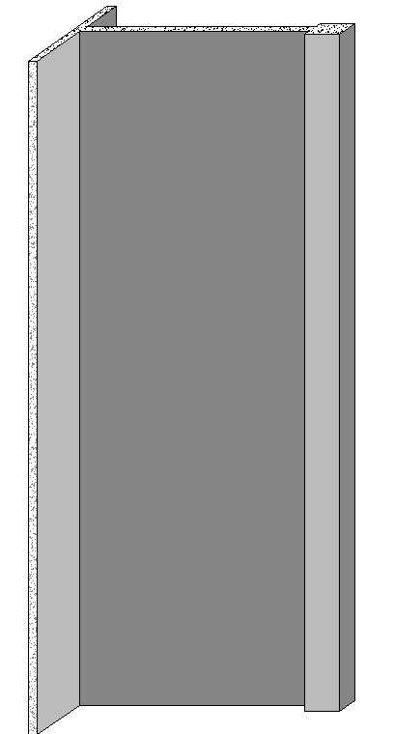
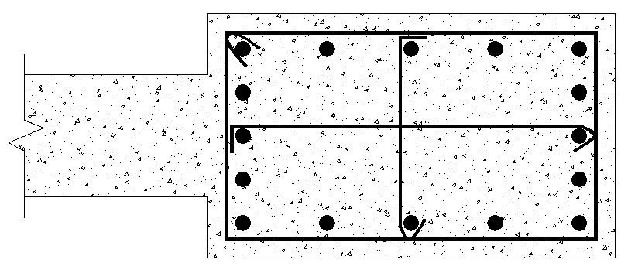
Shear Wall Re-Design
Katie
Ritter
SW-4
Boundary Element Design
DEVELOPING A PROTOTYPE
STRUCTURAL OPTION
Residence Inn
Proposal & Goals
Original Structure
Architectural Design
Gravity System Re-Design
Lateral System Re-Design
Summary & Next Steps
Questions
Faculty Advisor:
Dr. Ali Memari
The Pennsylvania
State University
April 14, 2009
12”
(16) #10
24”
118’
M_{u} = 51,115 ft-k
P_{u} = 2,169 k
V_{u} = 640 k
40”
(5) #5 ties @ 6” vertical spacing
(2) curtains #9 @ 12” EW
Shear & Flexural Reinforcing
42’

Slide 18
Preliminary Prototype Feasibility
Katie
Ritter
DEVELOPING A PROTOTYPE
PROS
  Loading criteria meets demands of large geographic area
  Design capable of having minimal impact on architecture & interiors
CONS
  Potentially significant increase in material CO$T to ‘overdesign’
  Impossible to ‘pre-engineer’ completely due to multiple assumptions that must be made upfront
Summary of Assumptions for Prototype
Wind
  V ≤ 120 mph
  Closely spaced obstructions nearby
Seismic
    Site Class D
    SDC-D
    Snow
      Ground snow load = 30 psf
STRUCTURAL OPTION
Residence Inn
Proposal & Goals
Original Structure
Architectural Design
Gravity System Re-Design
Lateral System Re-Design
Summary & Next Steps
Questions
Faculty Advisor:
Dr. Ali Memari
The Pennsylvania
State University
April 14, 2009

Slide 19
Summary & Next Steps
Katie
Ritter
NEXT STEPS…
Conference room lighting design
Re-design of transfer girders
Perform modal response spectrum analysis & identify if resulting loads are more critical than ELF
  Re-design & re-model shear walls based on updated loads
    Reinforcement detail @ openings
    Check drift & modify as necessary
    Re-check column design with displacements
    Cost analysis of prototype
DEVELOPING A PROTOTYPE
ARCHITECTURAL BREADTH
Design new office suite floors
  Embrace upscale design
  Provide green roof space for residents
  Maintain all existing vertical transportation routes/mechanical shafts & penetrations
LIGHTING BREADTH
Innovative conference room lighting design
STRUCTURAL DEPTHS
Check original floor design for increased loads
Re-design gravity columns
Re-design transfer girders @ 2nd Floor
Develop loading criteria for prototype
Apply loads to original structure & analyze
Shear wall re-design
  Develop lateral structural solution that satisfies code requirements with new demands
  Maintain original shear wall locations
  Evaluate feasibility of the prototype structure
    Variables to consider
    Cost
STRUCTURAL OPTION
Residence Inn
Proposal & Goals
Original Structure
Architectural Design
Gravity System Re-Design
Lateral System Re-Design
Summary & Next Steps
Questions
Faculty Advisor:
Dr. Ali Memari
The Pennsylvania
State University
April 14, 2009

Slide 20

QUESTIONS?
Katie
Ritter
DEVELOPING A PROTOTYPE
STRUCTURAL OPTION
Special thanks to:
Advisor: Dr. Ali Memari
Dr. Andres Lepage
Professor Kevin Parfitt
Holbert Apple Assoc.
LTD Management Co.
JN+A
Clancy + Theys Construction Co.
AE Faculty & Staff
Family & Friends
Residence Inn
Proposal & Goals
Original Structure
Architectural Design
Gravity System Re-Design
Lateral System Re-Design
Summary & Next Steps
Questions
Faculty Advisor:
Dr. Ali Memari
The Pennsylvania
State University
April 14, 2009

